Slide 1
Save on School
Expenses with Gift Cards
DRAG & DROP
SCHOOL LOGO HERE
Benefits of joining SCHOOL NAME’S RaiseRight Program

Slide 2
Benefits of Earning Money with RaiseRight
It’s Easy—Shopping online through RaiseRight and using gift cards to pay for everyday expenses fits into your daily life.
It’s Effective—Brands automatically give up to 20% back to the school. Earnings are shared with you to offset costs.
It’s Limitless—Each family can earn $1,000 or more per year toward expenses.
It’s Flexible—With eGift cards, a mobile app, and a browser extension, earning can happen anywhere, anytime.

Slide 3
You buy gift cards
How does gift card fundraising work?
The brand gives back
Earnings go toward expenses
You get the full value — no extra money comes out of your pocket. Buy gift cards and eGift cards from hundreds of popular brands.
Earn money simply by using gift cards to pay for everyday purchases instead of cash or credit cards.
A percentage of every gift card purchase automatically goes back to the school as earnings.
The school shares earnings with participating families to offset tuition and other school-related costs.

Slide 4
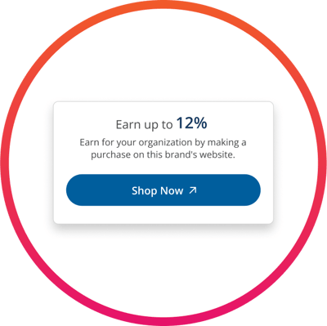
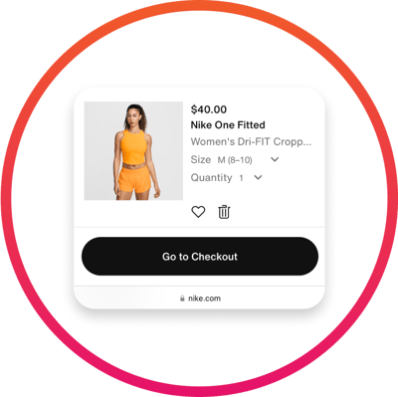
Select a Brand
How does shopping online work?
Go shopping
Earn
Browse 550+ brands on RaiseRight.com or the RaiseRight mobile app that offer online earnings.
Earn money simply by shopping online through RaiseRight.
Click through to the brand’s website, and shop like you normally do.
Automatically earn by completing a purchase on the brand’s website.

Slide 5
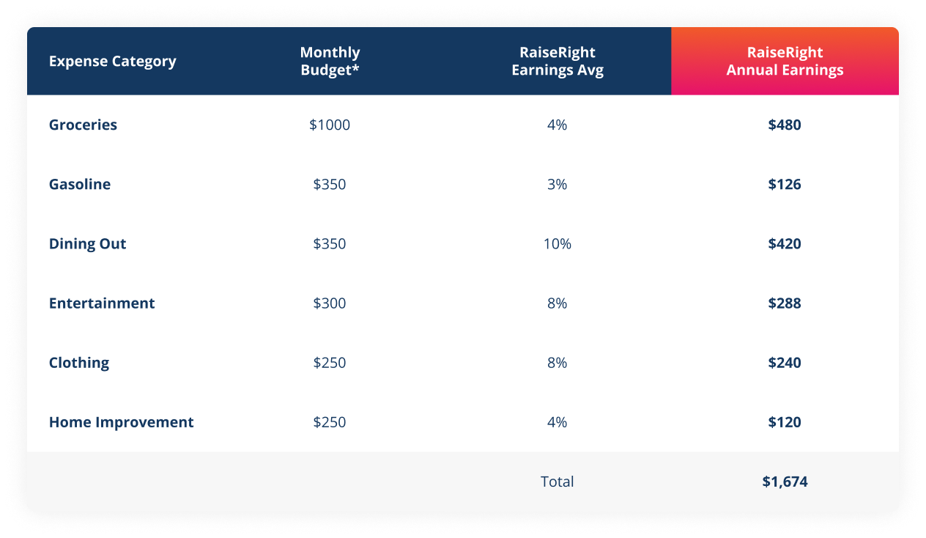
Everyday expenses = everyday earnings
*Based on average spend for a family of 4

Slide 6
What your earnings will fund
EDIT THIS SECTION TO INCLUDE WHAT YOUR RAISERIGHT PROGRAM FUNDS
Tuition and other school expenses
Extracurricular activities
Every gift card purchase automatically earns money! The school shares XX% of all earnings back with participating families.
Field Trips
Sports & playground equipment
Facility improvements
Fun fact! In 2023, the highest-earning school fundraiser on RaiseRight’s platform raised $206,849.

Slide 7
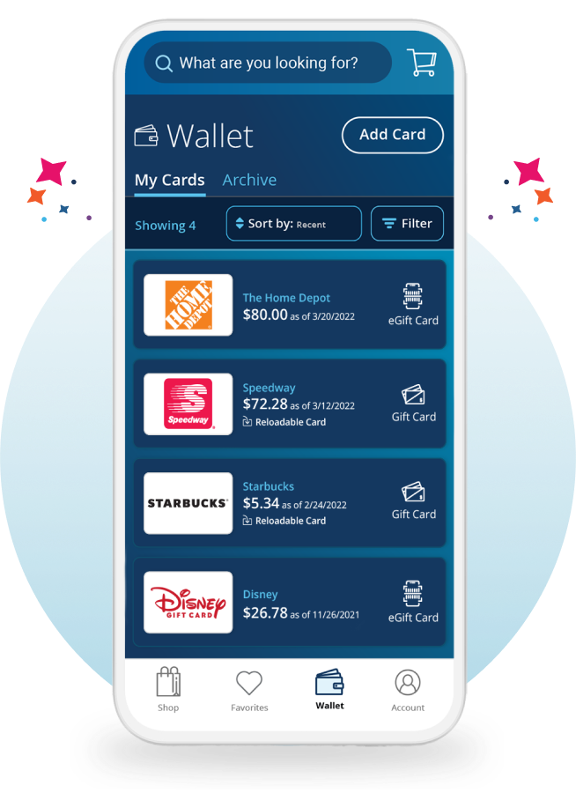
Earn on the go with the RaiseRight app
Shop for and purchase gift cards anywhere, anytime.
Instantly access your eGift cards and scan them at checkout while shopping, directly from your account Wallet.
Add funds to reloadable gift cards anytime. Every time you add funds, you earn!
Send referral invites to your friends and family so they can join and earn for your student.
Download the RaiseRight app for free
7

Slide 8
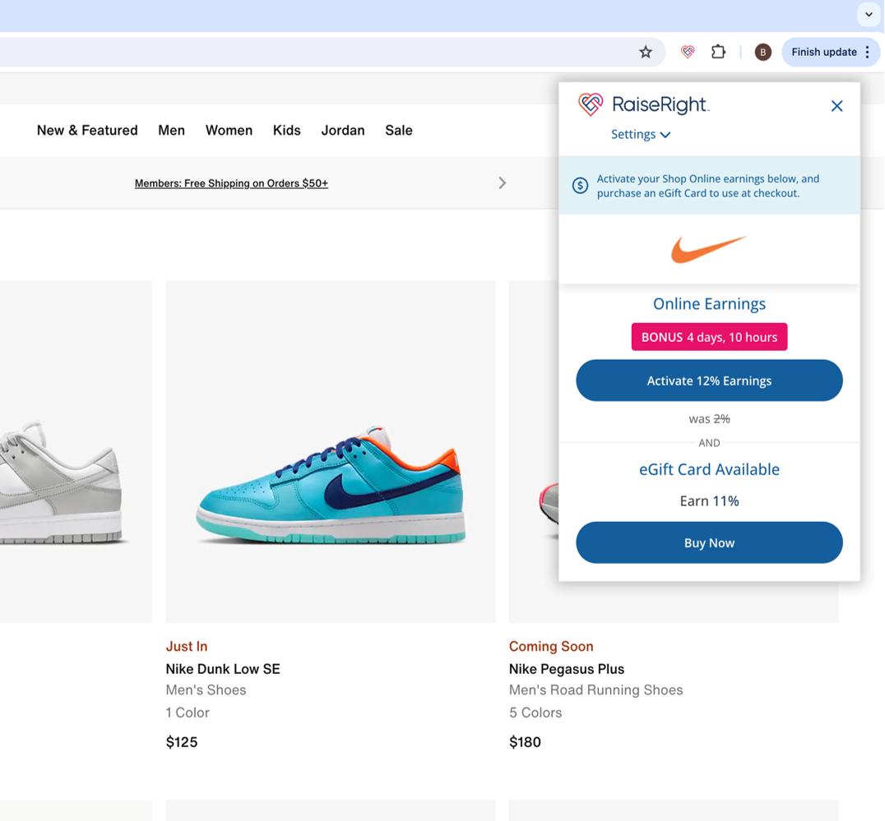
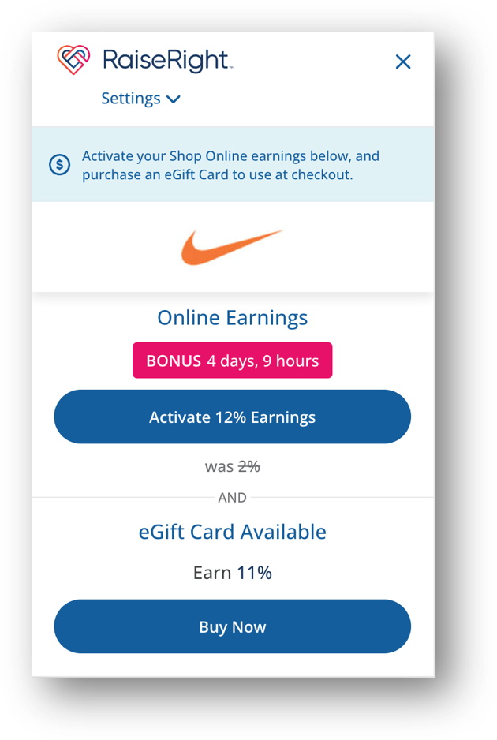
Never miss out one earnings while shopping online
Install the RaiseRight Earnings Extension to your desktop browser to get real-time earning reminders while shopping online.
Conveniently activate online earnings in a single click.
Quickly buy eGift cards to use as payment for your online purchases.
Install for FREE on Chrome or Edge browsers
8

Slide 9
eGift Cards
3 Gift Card Types
Physical Gift Cards
Reloadable Gift Cards
3 easy payment options are available: Purchase gift cards securely and directly using your bank account, debit card,
or credit card.
Digital gift cards that are delivered instantly to your account “Wallet,” and accessible right from your phone—they can be scanned by the retailer for quick checkout.
Whether you’re an online, contactless shopper or prefer to have your card in-hand, there is a gift card type available for you.
Plastic or paper-based gift cards that are shipped to your organization or can be mailed direct to your home address using the Ship to Home feature.
Allow you to electronically add more funds onto existing physical cards purchased from RaiseRight.

Slide 10
How to get started
1. Join the program
2. Create a secure account
3. Start earning
Scan the QR Code or sign up at RaiseRight.com/Enroll using the enrollment code provided by [COORDINATOR NAME].
Scan the QR code to join [SCHOOL NAME]’s RaiseRight program and start earning.
Complete the short signup form.
DOWNLOAD THE QR CODE FROM YOUR COORDINATOR DASHBOARD. DRAG & DROP IT HERE
Buy gift cards and eGift cards from hundreds of popular brands.
For more information, contact our program coordinator:
[COORDINATOR NAME]
[COORDINATOR EMAIL / PHONE]

